Slide 1
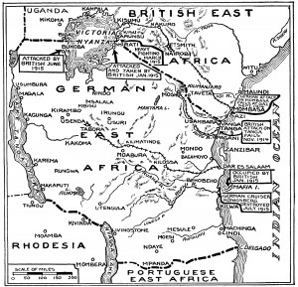

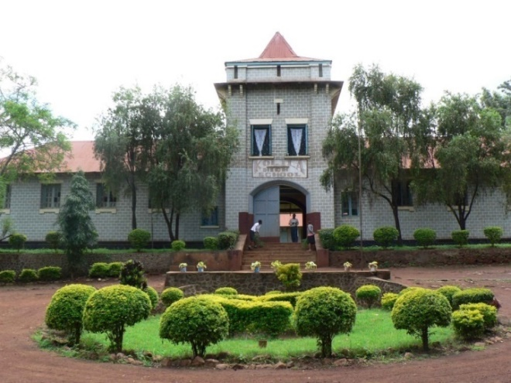
Critical historical geography and youth studies in Tanzania
Topographies of Power
Frances Vavrus, Ph.D.
University of Minnesota

Slide 2
Tanzania and the Kilimanjaro Region

Slide 3
Old Moshi and Primary School Sites
[CLICK ONCE TO GET ARROW]

Slide 4
Design of Longitudinal Study
2000 | 2001-2002 | 2006-2007 | 2012
Parental survey interviews (N=277) | Parental survey interviews (N=128) | Parental survey interviews (N=277) | Parental survey (N=260)
Standard 6 & 7 student surveys (N=277) |  | Interviews with former Std. 7 students (N=36) | Interviews with same former Std. 7 students (N=20)
 | Focus group discussions with parents | Focus group discussions with parents

Slide 5
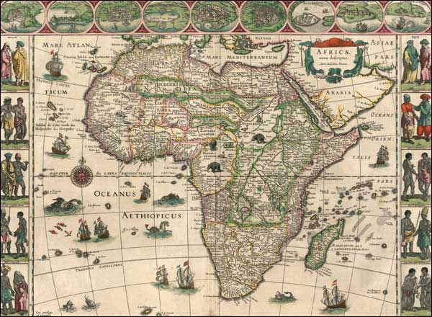
The Power of Topography...
“The presumption that
spaces are autonomous
has enabled the power
of topography to conceal
successfully the topography of power.”
Gupta, A., and Ferguson, J. (1992). Beyond ‘culture’: Space, identity, and the politics of difference. Cultural Anthropology 7(1): 6-23.

Slide 6
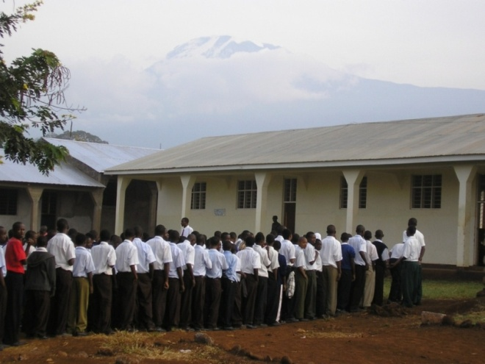
...and the Topography of Power
“by taking a preexisting, localized ‘community’ as a given starting point, it fails to examine sufficiently the processes (such as the structures of feeling that pervade the imagining of community) that go into the construction of space as place or locality in the first instance....”
Gupta, A., and Ferguson, J. 1997. Culture, power, place: Explorations in critical anthropology. Durham, NC and London: Duke University Press.

Slide 7
Old Moshi and Primary School Sites
[CLICK ONCE TO GET ARROW]

Slide 8
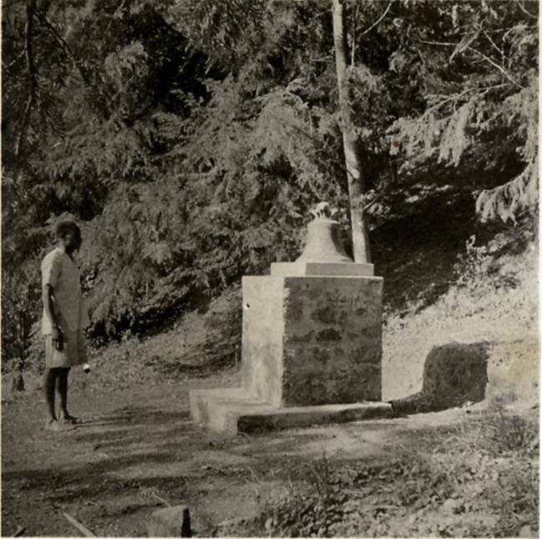
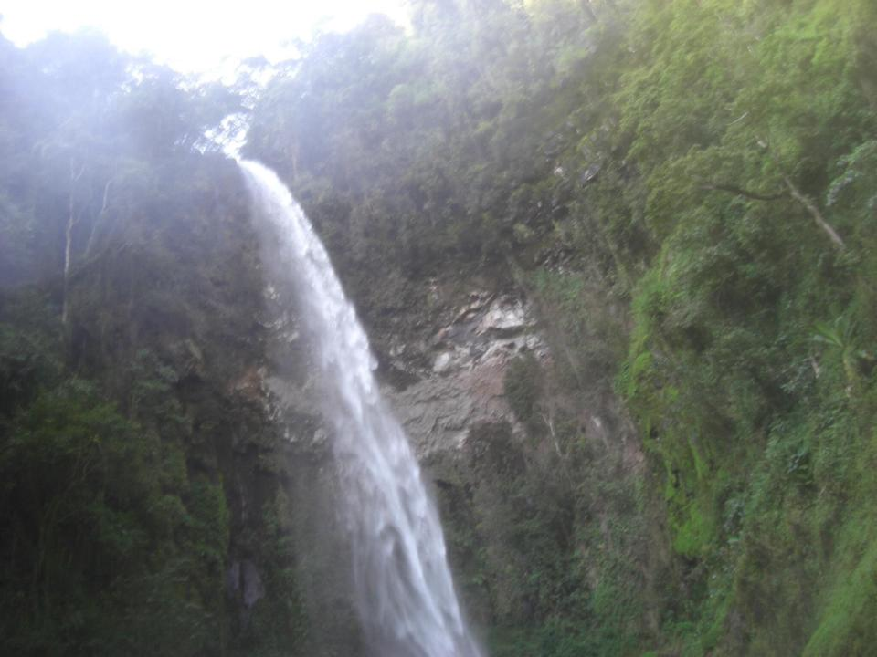
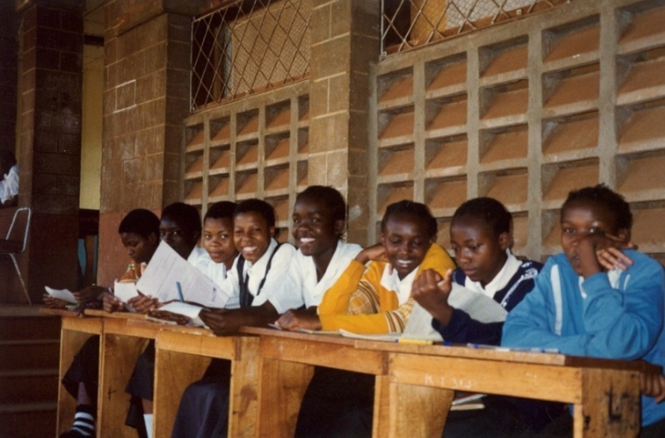
Discussion and Implications
“Places are not inert containers. They are politicized, culturally relative, historically specific, local and multiple constructions.”
Rodman, M.C. 2003. Empowering place: Multilocality and multivocality. In The anthropology of space and place: Locating culture, eds. S.M. Low and D. Lawrence- Zúñiga, pp. 204-222. Malden: Blackwell.

